Slide 1
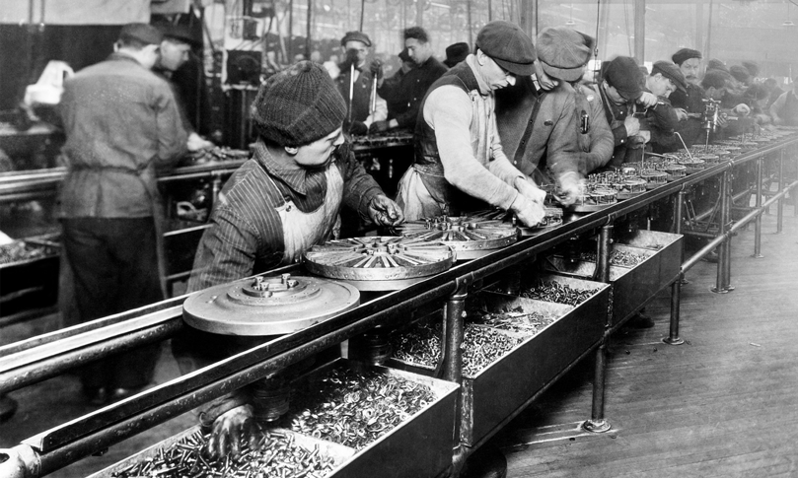
The Industrial Revolution (1750–1914)
Lesson 3 The Second Industrial Revolution

Slide 2
The Industrial Revolution (1750–1914)
Lesson 3 The Second Industrial Revolution
Learning Objectives
Describe the impact of new technology on industry, transportation, and communication.
Understand how big business emerged.
Summarize the impact of medical advances in the later 1800s.
Describe how cities changed and grew.
Explain how conditions for workers gradually improved.

Slide 3
The Industrial Revolution (1750–1914)
Lesson 3 The Second Industrial Revolution
Key Terms
Henry Bessemer
Alfred Nobel
Michael Faraday
dynamo,
Thomas Edison
interchangeable parts,
assembly line.
Orville and Wilbur Wright
Guglielmo Marconi
stock,
corporations,
cartel,
germ theory.
Louis Pasteur
Robert Koch
Florence Nightingale,
Joseph Lister
urban renewal,
mutual-aid societies,

Slide 4
Science and Technology Change Industry
The Bessemer Process Transforms Steel
Henry Bessemer and William Kelly invent a new way of making steel, which is lighter, stronger, and cheaper than iron
This will be used in the making of buildings, railroads
Steel output for countries will skyrocket
Innovations in Chemistry
Chemical innovations will increase food production
Dynamite will be invented at this time by Alfred Noble
Electricity Replaces Steam Power
By the late 1800’s this will happen
Alessandro Volta will develop the first battery
Michael Faraday creates the first simple electric motor and the first dynamo, a machine that generates electricity.
Thomas Edison invents the first lightbulb allowing for factories and other establishments to be open later

Slide 5
Science and Technology Change Industry
Improved Methods of Production
To improve production manufacturers designed goods with interchangeable parts
They also start to use the assembly line method of production
These things along with division of labor will allow goods to be made more efficiently and cheaper

Slide 6
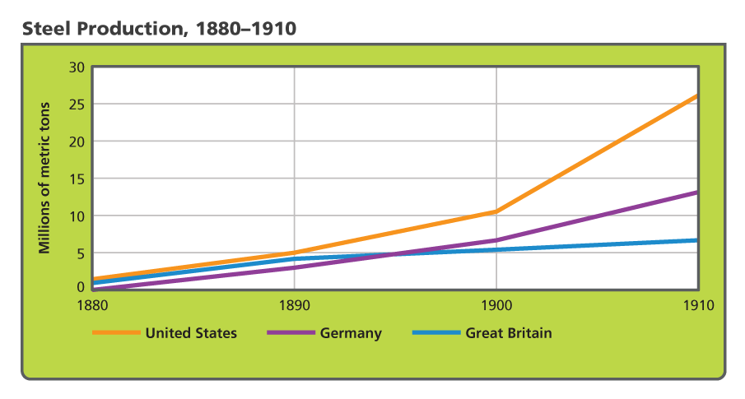
Science and Technology Change Industry
By the late 1800s, steel was the major material used in manufacturing tools. Analyze Graphs Between 1890 and 1910, which nation had the greatest increase in steel production? The smallest?

Slide 7
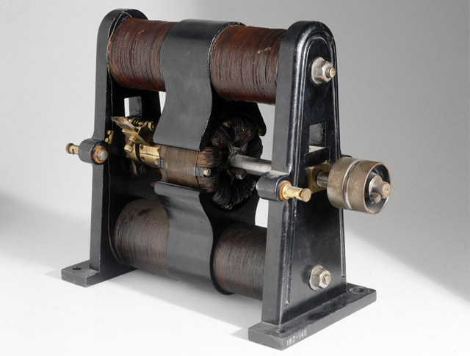
Science and Technology Change Industry
The electric dynamo, shown here, was invented by Michael Faraday in 1831. Dynamos generated the electricity used to power lights in factories and homes.

Slide 8
Advances in Transportation and Communication
The Age of the Automobile
Nikolaus Otto invented the gasoline powered internal combustion engine
Karl Benz receives the first patent for a 3 wheel car in 1886
Gottlieb Daimler introduced the first 4 wheel car
Henry Ford used the assembly line to mass produce cars, making the US a leader in the automobile industry
The First Airplane
1903 American bicycle makers Orville and Wilbur Wright invent and fly the first airplane in North Carolina
Passenger flight would not begin until the 1920’s
A Communications Revolution
Samuel Morse invents the Morse Code and in 1844 a line is lain between Washington D.C. and Maryland. Alexander Graham Bell invents the telephone and Guglielmo Marconi invents the radio

Slide 9
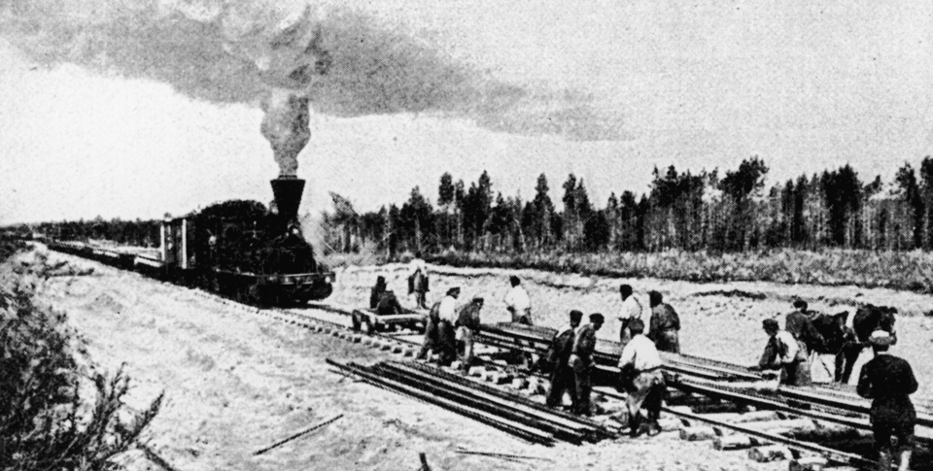
Advances in Transportation and Communication
Construction of the Trans-Siberian Railroad began in 1891. Work continued on various parts of the line until 1916.

Slide 10
Advances in Transportation and Communication
Analyze Information How did the Trans-Atlantic cable affect communications?

Slide 11
The Rise of Big Business
Investors Form Corporations
Companies sold thousand of share of stock in order to raise funds for expansion and to build things
Monopolies Dominate Industry
In Germany Krupp buys up coal and iron mines and the supply lines to feed his steel mills
John D Rockefeller dominates the petroleum industry
Andrew Carnegie dominates the steel industry
Opposing Views of Big Business
Some people admire these men, calling them captains of industry
They employ thousands of workers , and invest in worldwide ventures to help everyone out
Others call them robber barons, destroying competition as they grow. After they have taken control, they can raise prices and people must pay

Slide 12
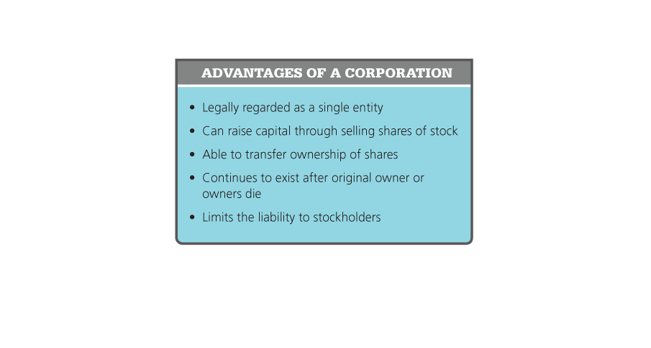
The Rise of Big Business
Corporations offered business people several advantages. Analyze Information What advantages did stockholders gain from the formation of corporations?

Slide 13
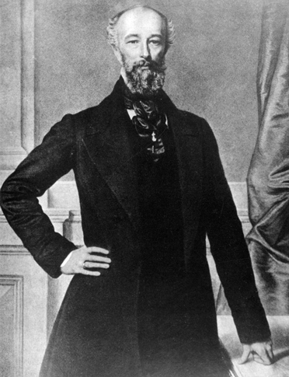
The Rise of Big Business
Alfred Krupp was the first industrialist to use the Bessemer process in Europe. Known as the 'Cannon King,' Krupp produced cast-steel cannons and other weapons of war.

Slide 14
Better Medicine, Nutrition, and Health
Combating Disease
1870 Louis Pasteur shows the link between microbes and disease
He develops the vaccine for rabies and anthrax, and the process that kills disease carrying microbes in milk.
Robert Koch identified the bacteria that caused tuberculosis in the 1880’s. The cure will take over 50 years to find
People will now understand how germs cause disease and this will lead them to bathing and changing clothes more
Improving Hospital Care
At first having surgery in a hospital was dangerous because of disease.
Florence Nightingale is going to introduce hygiene in war hospitals and later on in regular hospitals
Joseph Lister will have surgeons sterilize their equipment and that will lead to less deaths from infection after surgery

Slide 15
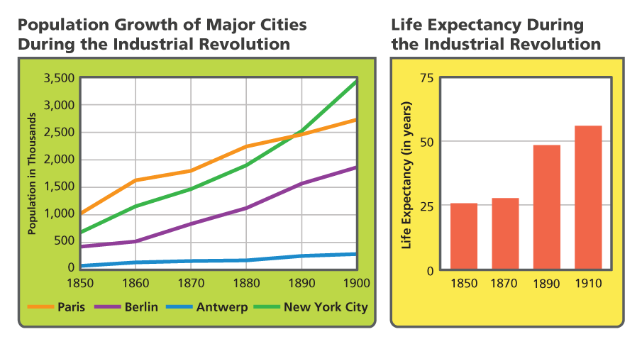
Better Medicine, Nutrition, and Health
Longer life expectancies contributed to population booms in major cities. Analyze Graphs Which city's population grew the most? How did life expectancy change between 1850 and 1910?

Slide 16
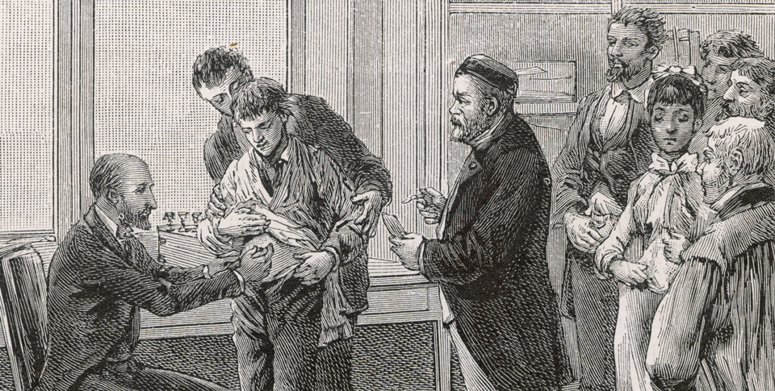
Better Medicine, Nutrition, and Health
The first person Louis Pasteur vaccinated was a nine-year-old boy named Joseph Meister, who had been bitten by a rabid dog. Meister failed to develop rabies.

Slide 17
City Life Changes
New Cityscapes
City layouts will change with industrialization.
Paris will tear down old medieval tenements and streets and build new public building and wide streets
In America, the rich will live outside of town. The poor will live in slums near the city center in order to be near the factories
Safety, Sanitation, and Skyscrapers
Cities become safer by adding electric lights, organizing police forces and firefighters
They become healthier by building sewage systems
In Paris 1852 there was 87 miles of sewer. By 1911 there will be more than 750 miles
Steel will help make tall buildings in 1900.
One family homes will be torn down in order to build multistory multifamily buildings

Slide 18
City Life Changes
Life in the Slums
Urban life will remain harsh for the poor
Families could be crammed into a single room with no ventilation and little light
Most buildings did not have running water
This will lead to disease
Illness or unemployment could leave a family homeless
High rate of crime and alcoholism
The Lure of City Life
City life will attract people
They will come because of work or excitement of a city
They will come for entertainment like music halls, opera houses, theaters, sporting events.

Slide 19
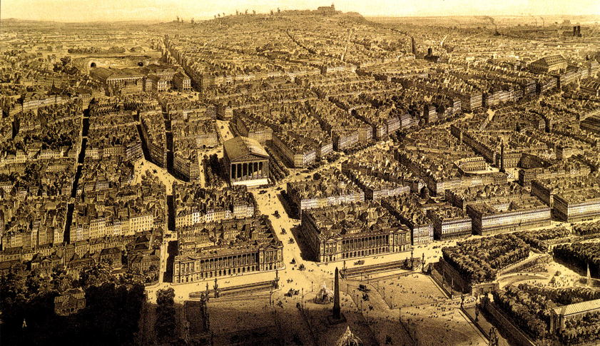
City Life Changes
This aerial view shows Paris around 1870, after being redesigned by Georges Haussmann.

Slide 20
The Working Class Wins New Rights
The Growth of Labor Unions
By the late 1800’s unions have been created
They use strikes to get management to meet their demands like 8 hour work days, more money for work or other benefits
Governments will pass laws to regulate working conditions
They will also start pension programs and disability insurance for workers
An Improved Standard of Living
Standards of living for workers will rise over time
They will have access to education, some to health care, others to vaccination. Some will even be able to leave the slums.
However there will be a large gap between workers and the middle class

Slide 21
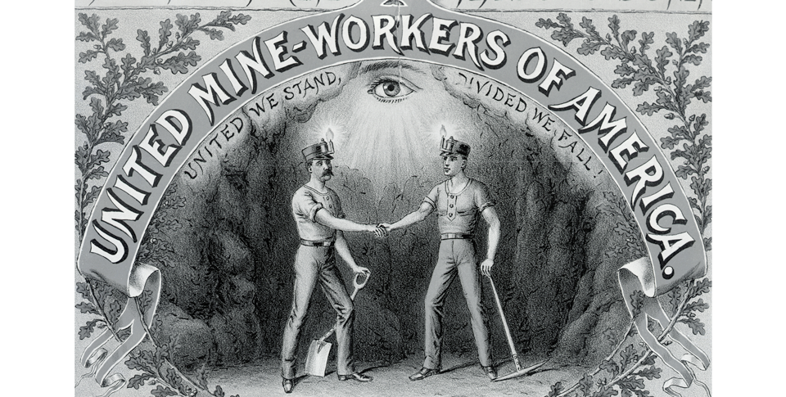
The Working Class Wins New Rights
This emblem comes from a United Mine Workers of America poster. Notice the motto beneath the name of the union. Analyze Images Why do you think the union chose that motto?

Slide 22
Quiz: Science and Technology Change Industry
How did Thomas Edison's invention of the light bulb affect industry?
A. Electric lights made it possible for factories to run after dark.
B. Having better lighting largely eliminated industrial accidents.
C. Bulb manufacturing became the biggest industry in the United States.
D. Brighter lights made people more productive so they worked fewer hours.

Slide 23
Quiz: Advances in Transportation and Communication
Which of the following had the greatest impact on transportation during the second Industrial Revolution?
A. the steam engine
B. the internal combustion engine
C. the Bessemer process
D. the dynamo

Slide 24
Quiz: The Rise of Big Business
Why did some business owners form corporations?
A. to regulate the free-enterprise system
B. to buy more stock in competitors' companies
C. to raise money to expand into different areas
D. to create a laissez-faire economy

Slide 25
Quiz: Better Medicine, Nutrition, and Health
Which factors caused the population of Europe to soar between 1800 and 1900?
A. Cities grew, and families had more children.
B. People bathed more and ate less.
C. The poor were treated at hospitals and survived surgeries.
D. Medicine advanced, and the death rate fell.

Slide 26
Quiz: City Life Changes
Which of the following changes to city life would be most likely to reduce the crime rate?
A. installing street lights
B. constructing sewer systems
C. erecting fine buildings
D. offering public entertainment

Slide 27
Quiz: The Working Class Wins New Rights
Why did some workers organize unions?
A. to support large corporations
B. to help women get factory jobs
C. to reduce work stoppages
D. to improve their working conditions

